Slide 1
ISS : INTELLIGENT SURVEILLANCE SYSTEM
An IOT based intruder detection system based on object and emotion recognition

Slide 2

ISS : INTELLIGENT SURVEILLANCE SYSTEM
by
AVILIKONDA PRAVEEN KUMAR
(22001F0005)
Under the guidance of
Dr. P. CHENNA REDDY M.Tech., Ph.D
Professor
DEPARTMENT OF COMPUTER SCIENCE AND ENGINEERING
JAWAHARLAL NEHRU TECHNOLOGICAL UNIVERSITY ANANTAPUR
COLLEGE OF ENGINEERING
(Autonomous)
ANANTHAPURAMU-515002
ANDHRA PRADESH
2023 - 2024

Slide 3
contents
INTRODUCTION
EXISTING SYSTEM
DRAWBACKS
PROPOSED SYSTEM
ADVANTAGES
ARCHITECTURE
MODULES
SOFTWARE SPECIFICATIONS
HARDWARE SPECIFICATIONS
CIRCUIT DIAGRAM
ALGORITHMS
OBJECT AND EMOTION DETECTION USING YOLO
UMLs
OUTPUT SCREENS
PROJECT IMAGES
CONCLUSION
FUTURE SCOPE
REFERENCES

Slide 4
Introduction
The Intelligent Surveillance System is an IOT device designed to revolutionize the way security is managed, offering a comprehensive solution that enhances safety, efficiency, and situational awareness throughout the entire surveillance lifecycle.
The Intelligent Surveillance System offers advanced detection and analysis capabilities, allowing for the automatic identification of security threats, suspicious behavior, and anomalous activities in real-time.

Slide 5
Existing system
Existing Surveillance systems leverage a combination of sensors, surveillance technology, and alarm systems to detect, deter, and respond to security threats effectively.
These systems play a crucial role in protecting assets, premises, and individuals against unauthorized access, theft, vandalism, and other security risks.

Slide 6
DRAWBACKS
Limited Intelligent features.
Lack of Real-time screening capabilities.
False Alarms.
Lack of Remote Management features.

Slide 7
Proposed system
The proposed system provides Real-Time Screening capabilities for Real-Time Intruder detection.
Reduces false Alarms by identifying Intruders based on Object and Emotion recognition.
Provides Remote Management features.
The proposed system uses trained ML algorithms to differentiate Intruders from normal people.

Slide 8
ADVANTAGES
Remote monitoring.
Reduced false alarms.
Real-time screening.
Enhanced intruder detection.

Slide 9
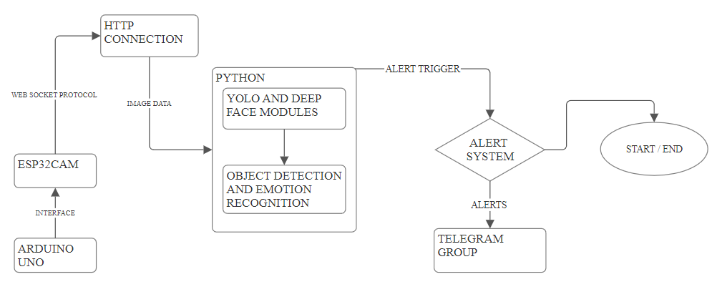
ARCHITECTURE Intelligent surveillance system

Slide 10
MODULES
1. Live Surveillance:
- 1.1 Provides users with live video feeds from surveillance cameras.
- 1.2 Allows users to select the live surveillance option for real-time monitoring.
2. Object Recognition:
- 2.1 Conducts real-time object detection in the live video feeds.
- 2.2 Enables users to select object recognition for identifying various objects
in the surveillance footage.

Slide 11
MODULES:
3. Emotion Detection:
- 3.1 Analyzes facial expressions and emotions in real-time from the live video feeds.
- 3.2 Allows users to select emotion detection for identifying emotions displayed
by individuals in the surveillance footage.
4. Alert System:
- 4.1 Triggers alerts based on detected objects and emotions in the live video feeds.
- 4.2 Notifies users promptly through email, SMS, or mobile apps upon
detecting concerning objects or emotions.

Slide 12
SOFTWARE SPECIFICATIONS:
Software Specifications:
Technology : Python, C++
Libraries : YOLO, OPEN CV, DEEPFACE, TENSORFLOW, MATPLOTLIB
Version : Python 3.6, C++
IDE : Arduino IDE, VS CODE

Slide 13
HARDWARE SPECIFICATIONS:
Hardware Specifications:
BOARDS : ARDUINO UNO, ESP32 CAM
RAM : 8 GB
Processor : AMD RYZEN R5
Hard Disk : 32 GB

Slide 14
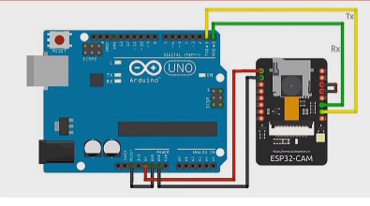
circuit Diagram:

Slide 15
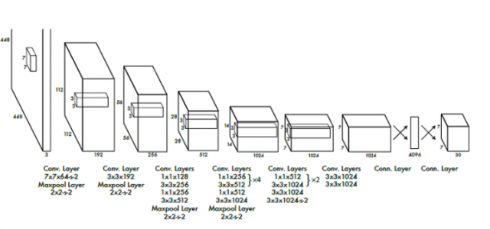
ALGORITHMS:
YOLO (You Only Look Once) is a deep learning algorithm for real-time object detection. It processes entire images in a single pass through a convolutional neural network (CNN), dividing them into a grid and predicting bounding boxes and class probabilities for objects. This simultaneous prediction enables real-time performance. YOLO uses non-maximum suppression to filter redundant detections, outputting the most confident predictions. Its efficiency and accuracy make it ideal for applications like surveillance, autonomous vehicles, and video analysis.

Slide 16
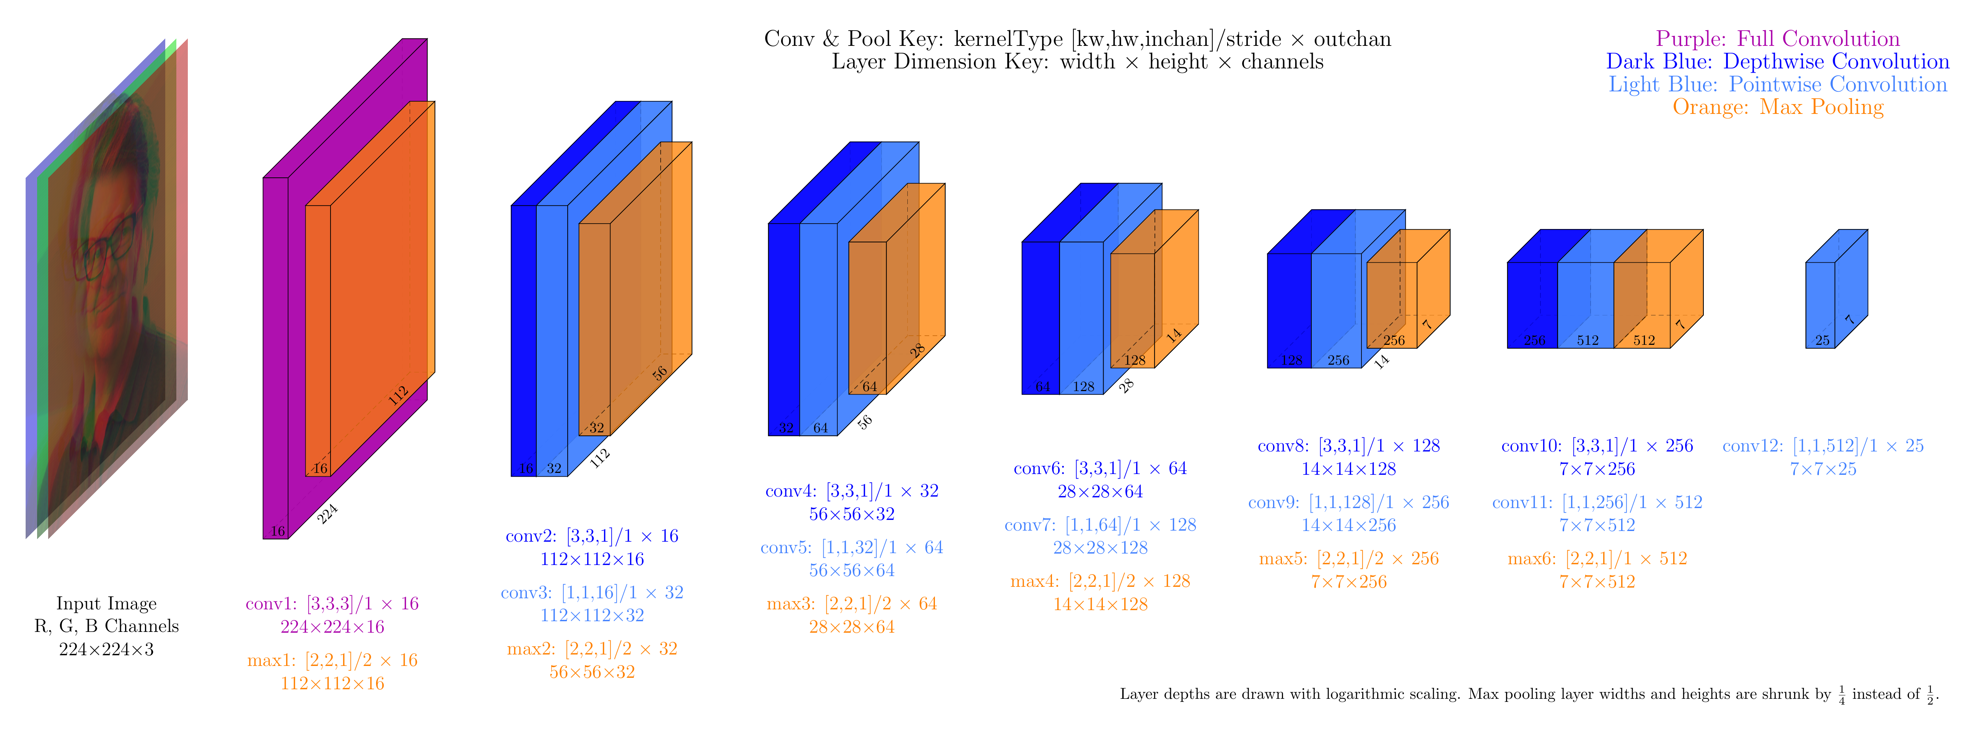
Object and Emotion Recognition using Yolo:

Slide 17
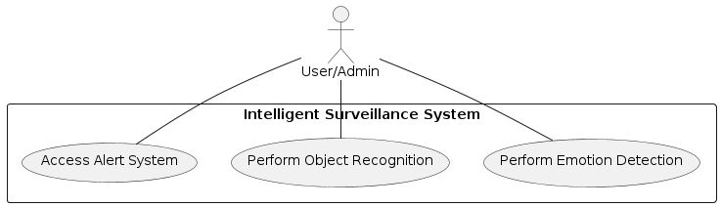
UMLs
Use-case Diagram:

Slide 18
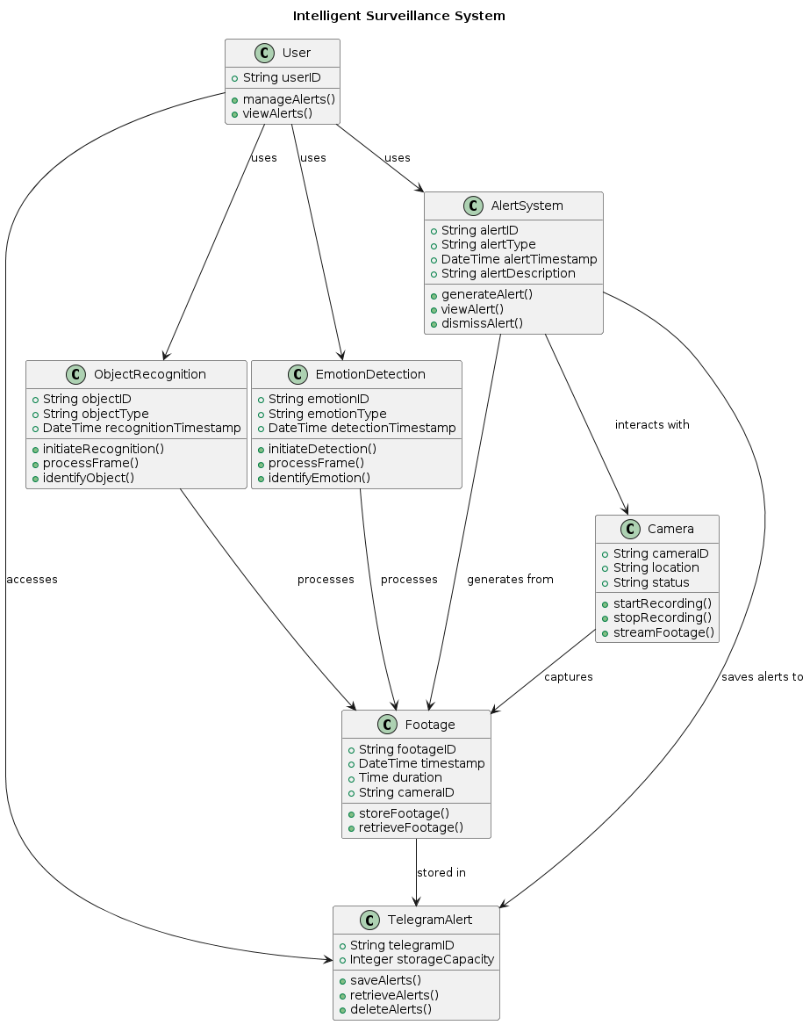
UMLs
Class Diagram

Slide 19
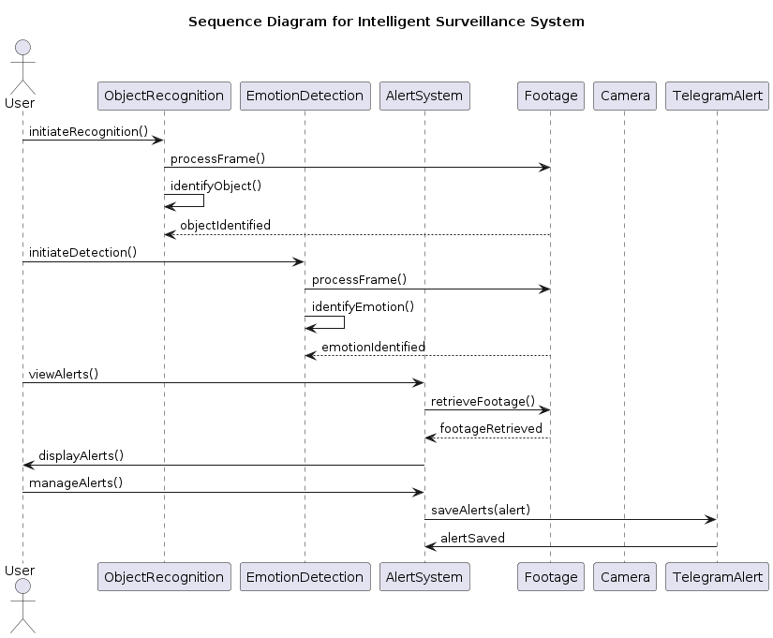
UMLs
Sequence Diagram

Slide 20
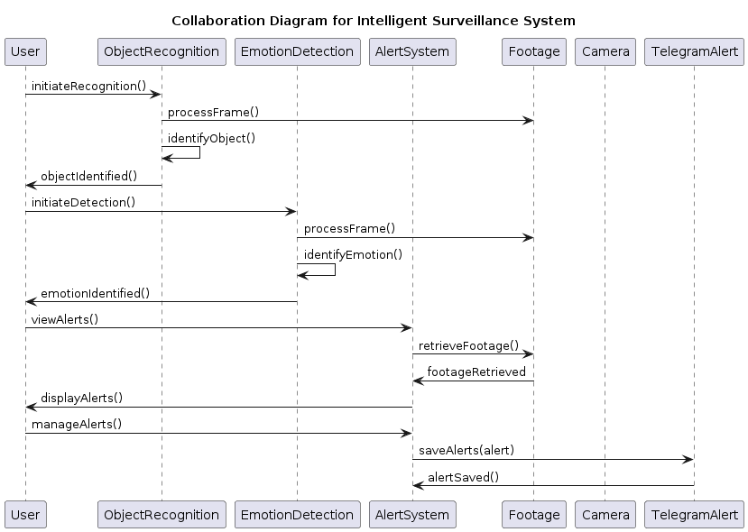
UMLs
Collaboration Diagram

Slide 21
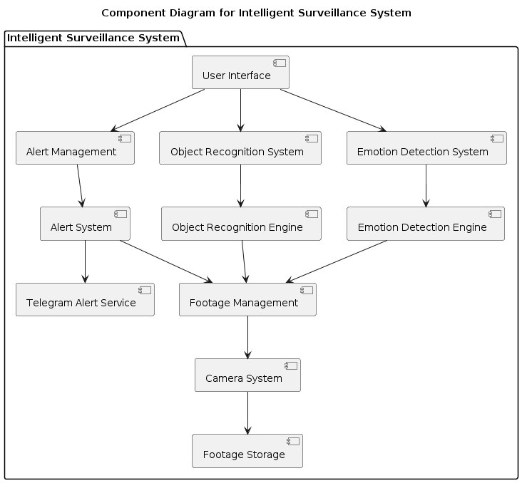
UMLs
Component Diagram

Slide 22
UMLs
Component Diagram

Slide 23
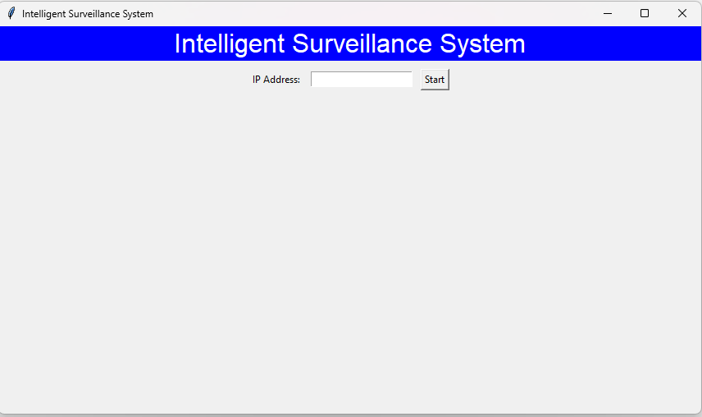
OUTPUT SCREENS
Home

Slide 24
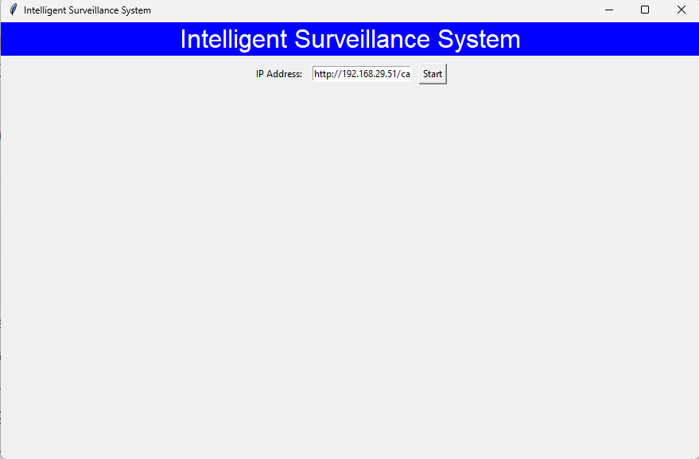
OUTPUT SCREENS
IP Address

Slide 25
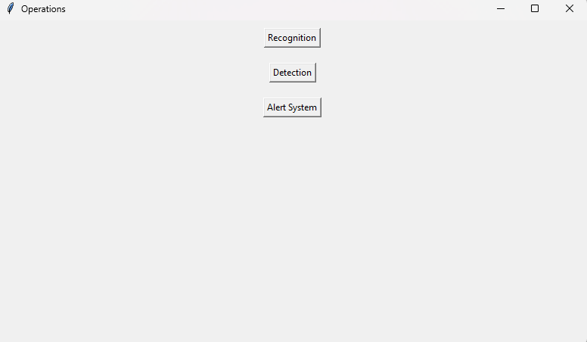
OUTPUT SCREENS
Operations

Slide 26
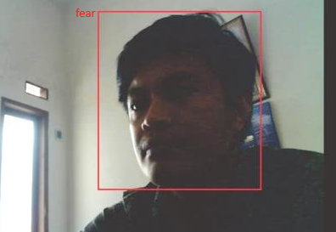
OUTPUT SCREENS
Emotion Recognition

Slide 27
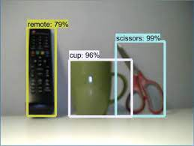
OUTPUT SCREENS
Object Detection

Slide 28
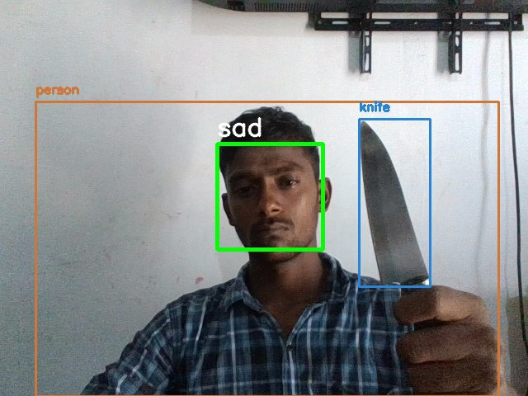
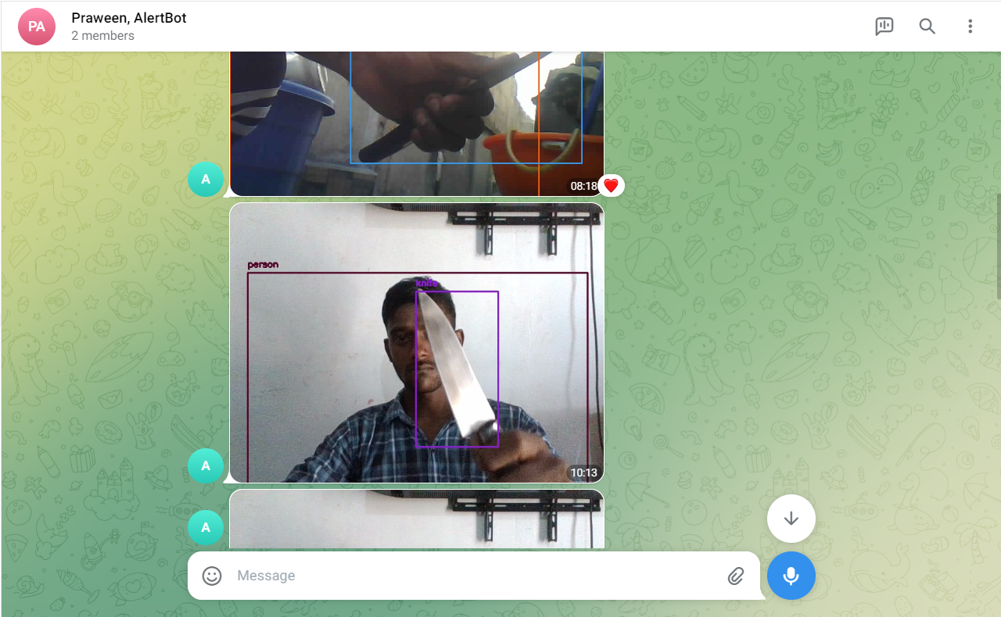
OUTPUT SCREENS
Alert System

Slide 29
OUTPUT SCREENS
Telegram group

Slide 30
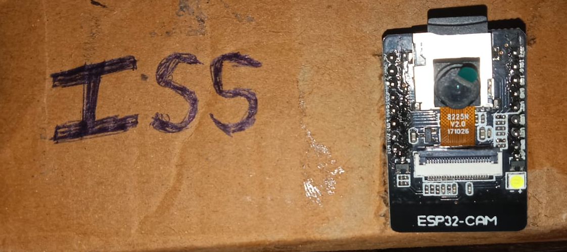
Project Images
front view

Slide 31
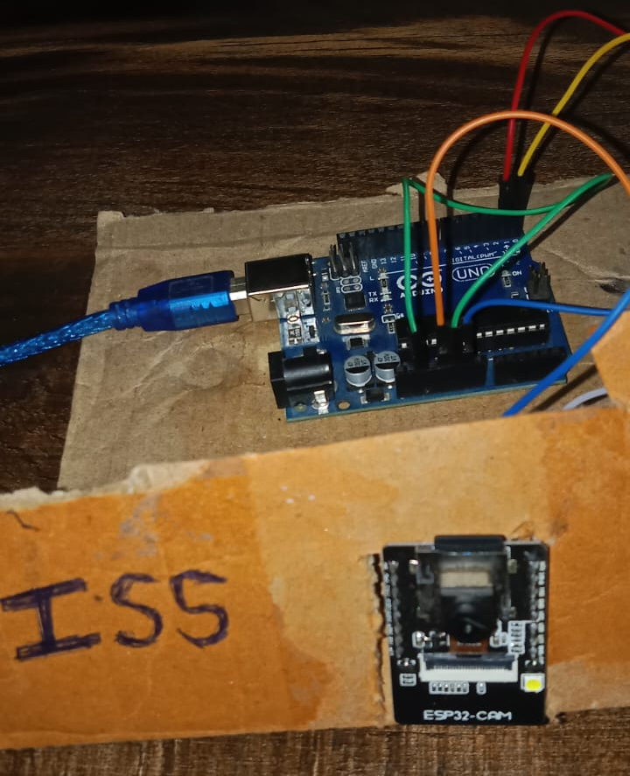
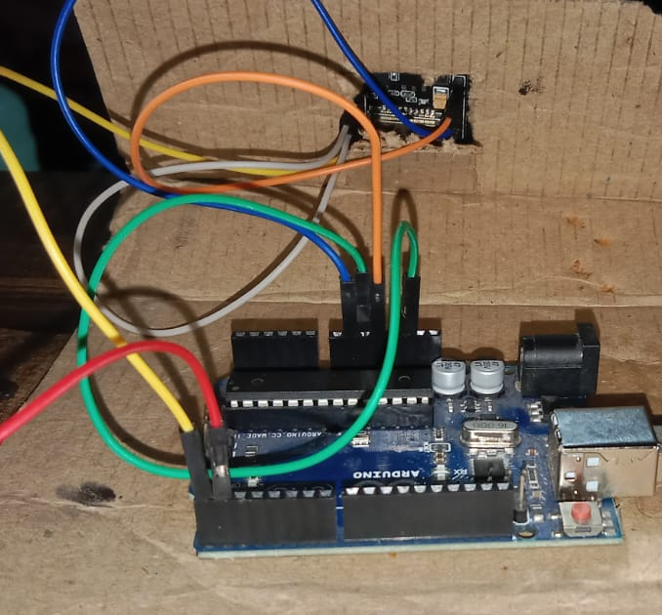
Project images
Top view
Back view

Slide 32
Conclusion
The Intelligent Surveillance System is set to redefine security and monitoring practices by offering a comprehensive, solution that integrates:
Real-time Object Recognition: Track objects in real-time, enhancing situational awareness and threat detection.
Real-time Emotion Detection: Aiding in identifying potentially hazardous or suspicious behavior.
Automated Alerts: Generating immediate alerts based on predefined criteria and minimizing potential risks.
Telegram Alert Group: Integrating with Telegram to send alerts to designated groups, ensuring that relevant personnel are immediately informed of any incidents, facilitating quick and coordinated responses.
This system aims to create a robust and intelligent surveillance environment, moving beyond traditional passive monitoring.
Join us in revolutionizing surveillance and security. Let's secure our spaces intelligently and efficiently. Let's secure with the Intelligent Surveillance System.

Slide 33
FUTURE SCOPE
The Intelligent Surveillance System envisions a future where surveillance and security are more advanced, accessible, and efficient. Our plans include:
AI-Powered Personalization: Tailoring surveillance operations to specific security needs and preferences of different environments, ensuring maximum effectiveness and efficiency.
Integration with Smart Home Systems: Providing seamless integration with smart home and IoT devices to create a holistic security ecosystem, enabling coordinated and automated responses to potential threats.
Expanded Functionalities: Introducing additional features such as license plate recognition, advanced facial recognition, and behavior analysis to cater to diverse security requirements and scenarios.
Cloud-Based Solutions: Developing scalable cloud-based surveillance solutions to ensure easy access, management, and storage of data, reducing the need for extensive on-site hardware.
Enhanced Cybersecurity Measures: Implementing robust cybersecurity protocols to protect surveillance data and systems from unauthorized access and cyber threats.
By embracing these advancements, the Intelligent Surveillance System aims to stay at the forefront of security technology, providing cutting-edge solutions to ensure safety and peace of mind in an ever-evolving world.

Slide 34
REFERENCES:
Radhakrishnan, S.; Ramanathan, R. A support vector machine with Gabor features for animal intrusion detection in agriculture fields. Procedia Comput. Sci. 2018, 143, 493–501. [Google Scholar] [CrossRef]
Jeevitha, S.; Kumar, S.V. A study on sensor based animal intrusion alert system using image processing techniques. In Proceedings of the 2019 Third International Conference on I-SMAC (IoT in Social, Mobile, Analytics and Cloud) (I-SMAC), Palladam, India, 12–14 December 2019; IEEE: Piscataway, NJ, USA, 2019; pp. 20–23. [Google Scholar]
Raiaan MAK, Fahad NM, Chowdhury S, Sutradhar D, Mihad SS, Islam MM (2023) IoT-Based object-detection system to Safeguard Endangered Animals and Bolster Agricultural Farm Security. Future Internet 15(12):372

Slide 35
THANK YOU

